Slide 1

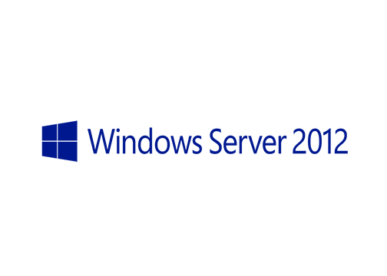
MegaSeries
Data Deduplication

Slide 2
Intro
New feature in Windows Server 2012
Dedup is usually found on storage devices and appliances
Optimizes the space consumed on a specific volume by finding data that is stored multiple times
Can be enabled on a per volume basis
It offers Powershell CmdLets and Server Manager integration

Slide 3
Usage scenarios (settings templates)
General purpose file server
Hyper-V/VDI data
Backup workload

Slide 4
How it works
After it is enabled on a volume it scans the volume and splits data into chunks
All unique chunks are placed into a chunk store, the duplicate ones are deleted and links from the chunks to the actual files are formed
From time to time the chunk store is scanned and unlinked chunks are deleted; also any corruption is remediated
All these jobs are done through the Task Scheduler

Slide 5
Task types
Optimization : scans files, creates chunks, places them in the chunk store and creates links
Garbage collection : reclaims space by deleting unlinked chunks
Integrity scrubbing : scans for corruption in the chunk store and, if possible, fixes it
Unoptimization : disables deduplication for a volume; it is run manually

Slide 6
https://www.youtube.com/channel/UCcZ-jLbPwNr8E_v9-65n8Iw https://github.com/itknowledge4

